Slide 1



KPN MUZIX APPLICATION
Presented By
Priya L P
MSc. CS
Nithya Sree P
BE ECE
Hongken T
BSc. CS

Slide 2
Introduction
Our Muzix application is a movie application.
This app is designed to see all the movies of various languages & genres.
This app uses a 3rd party API to fetch the movies.
This app is compatible with all devices like Desktop, Tablet, Mobile, etc…
In our app all movies are present including the latest movies .

Slide 3
Features of the App
See the movie info.
Search Any Movie.
Add/Remove Favourites.
Recommend movies based on Favourites.
Watch Movie Trailer

Slide 4
Tools & Technologies
IDE Tools
IntelliJ IDEA
VS Code
External API
TMDB API
YouTube API
FrontEnd
Angular
CSS
TypeScript
Bootstrap
HTML
BackEnd
Spring Boot
Eureka Server
API Gateway
Feign Client
Database
MongoDB
MySQL

Slide 5
Spring Boot
Spring Boot is an open source Java-based framework used to create a micro Service.
It is developed by Pivotal Team and is used to build stand-alone and production ready spring applications.

Slide 6
Angular
Angular is a platform and framework for building single-page client applications using HTML,CSS and TypeScript.
It implements core and optional functionality as a set of TypeScript libraries that you import into your applications.

Slide 7
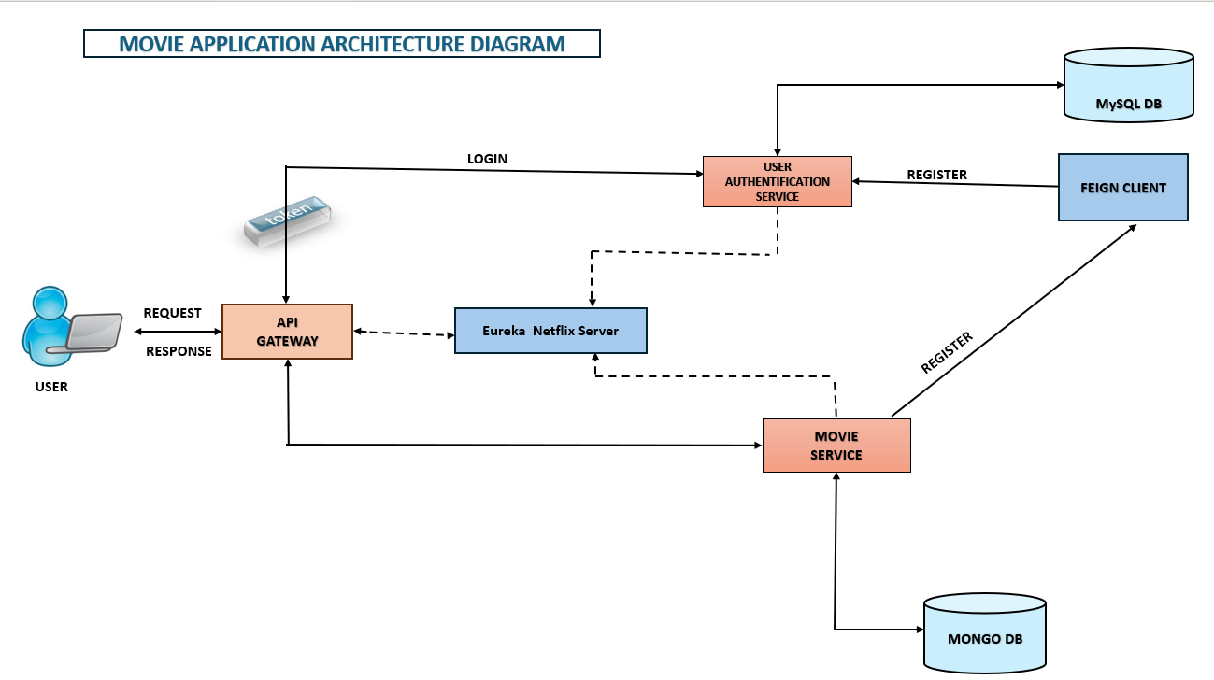

Slide 8
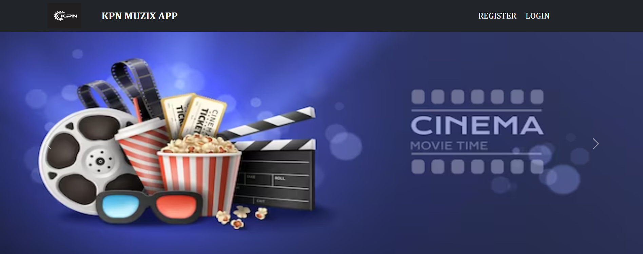
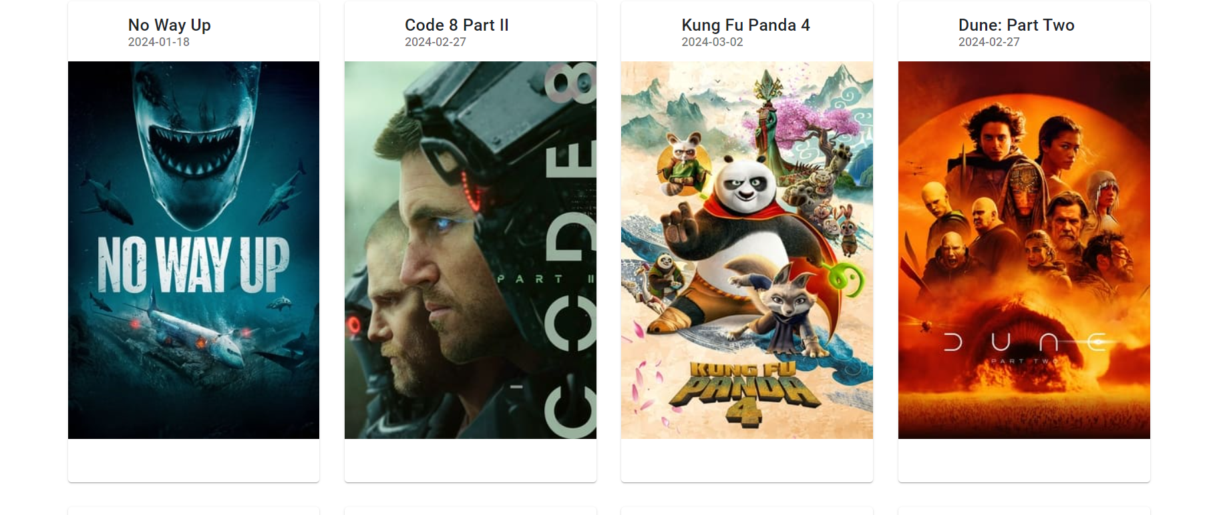
LANDING PAGE
REGISTER LOGIN

Slide 9
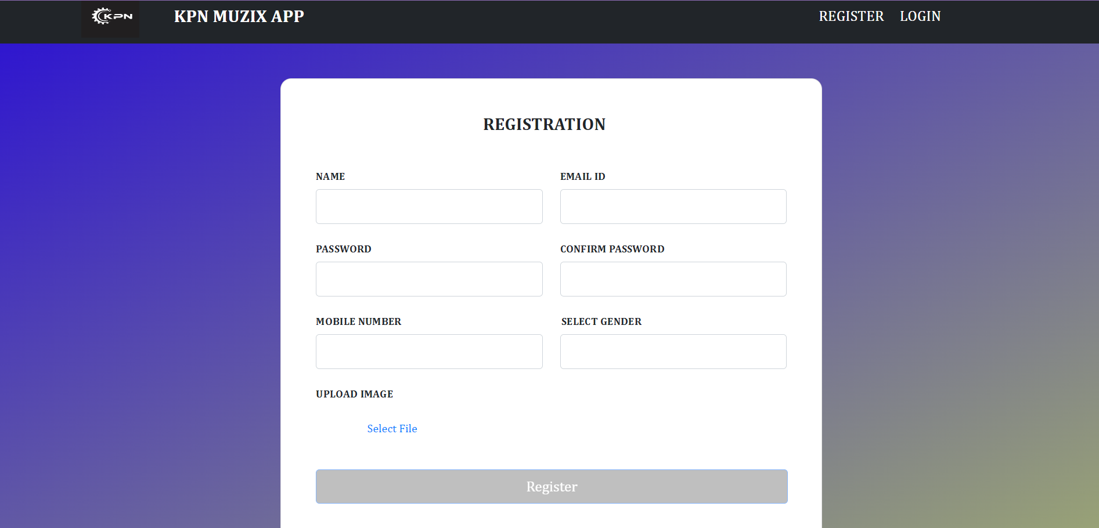
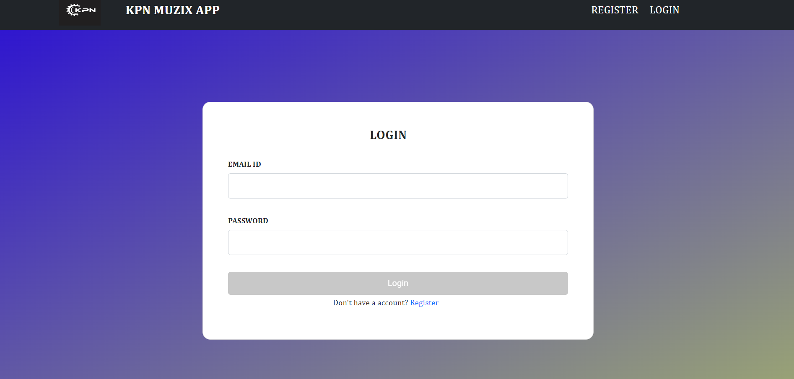
REGISTER & LOGIN PAGE

Slide 10
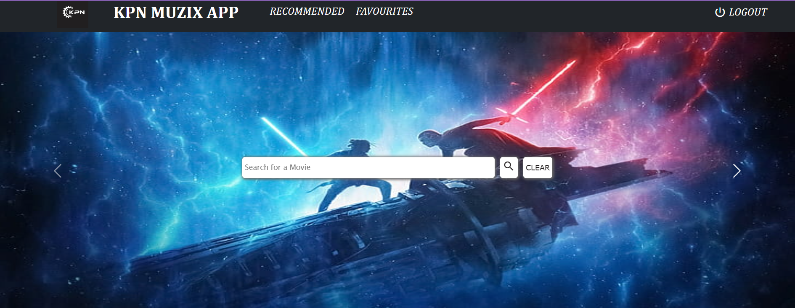
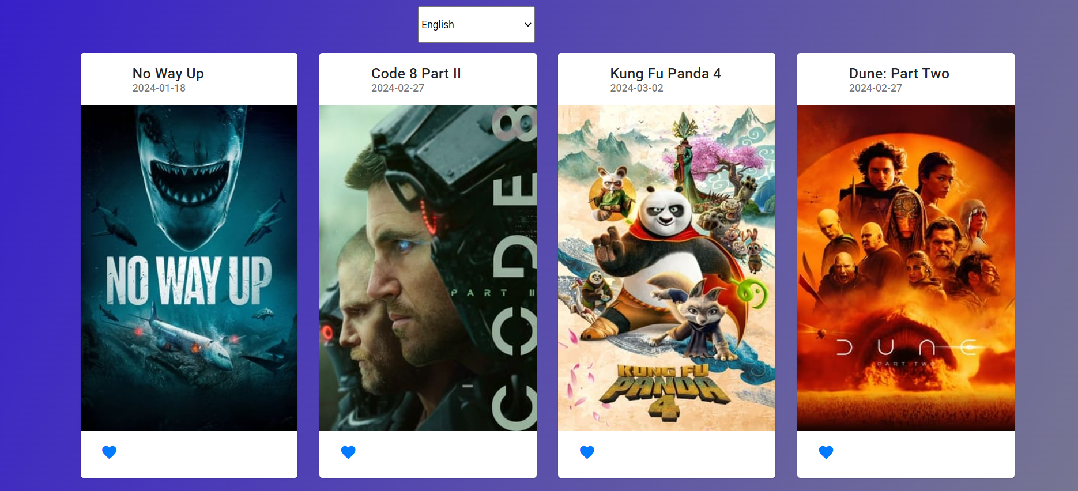
DASHBOARD VIEW
Search Movies
Favourite Movies
Add to favourite

Slide 11
Thank You

